Slide 1

Spatially resolved transcriptomics Method of the Year 2020 @ Nature Methods
Yunhao Wang Ph.D.
February 26, 2021
Department of Biomedical Informatics
Ohio State University

Slide 2
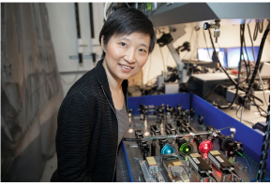
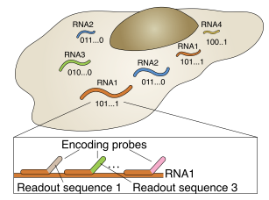
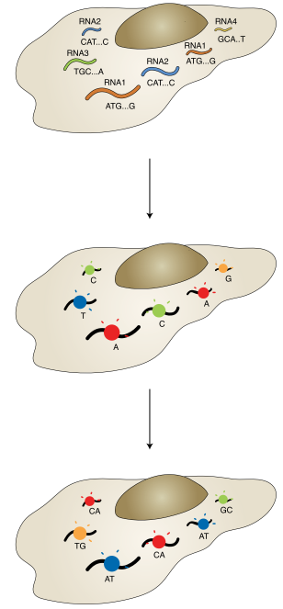
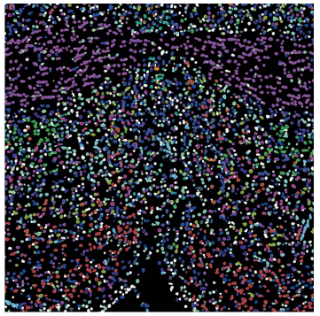
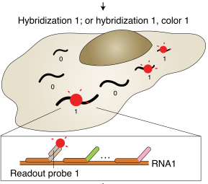
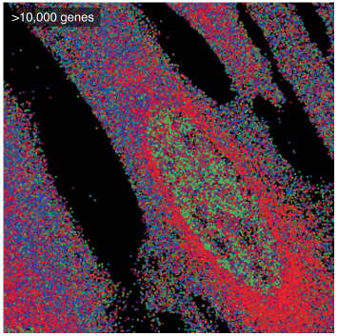
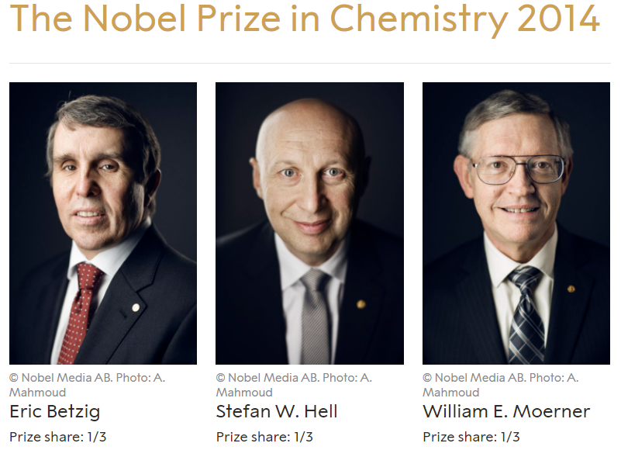
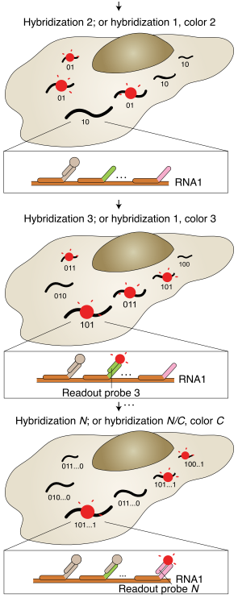
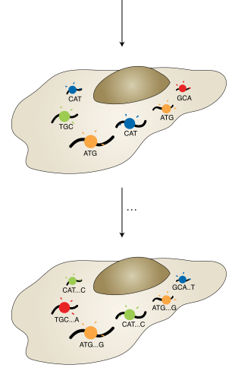
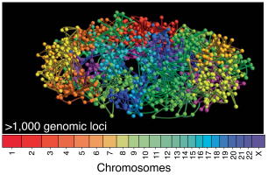
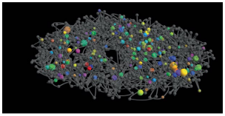
Spatially resolved single-cell genomics and transcriptomics by imaging
Multiplexed FISH
In situ sequencing
Cell atlas of a complex tissue
Single-cell
In a tissue (brain)
>1 M cells
Xiaowei Zhuang @ Harvard & HHMI
STORM
-- stochastic optical reconstruction microscopy
Super-resolution Microscopy
Method of the Year 2008 @ Nature Methods
Intracellular transcriptome organization
Single-molecule
In a single cell
>10 K genes
3D genome organization & transcriptional bursts
Single-molecule
In a single nucleus
>1000 genomic loci
Single-molecule
In a single nucleus
>1000 genes
Betzig: Aug 10, 2006; Mar13, 2006; PALM Science; idea in 1995
Zhuang: Aug 9, 2006; Jul 7, 2006; Nature Methods

Slide 3
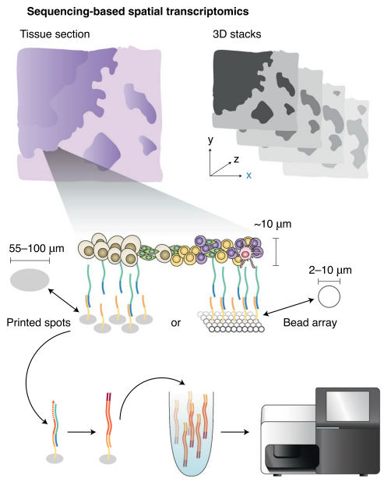
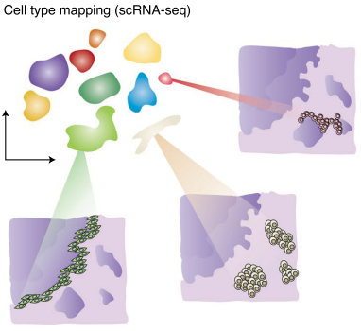
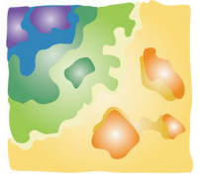
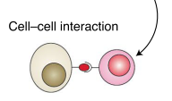
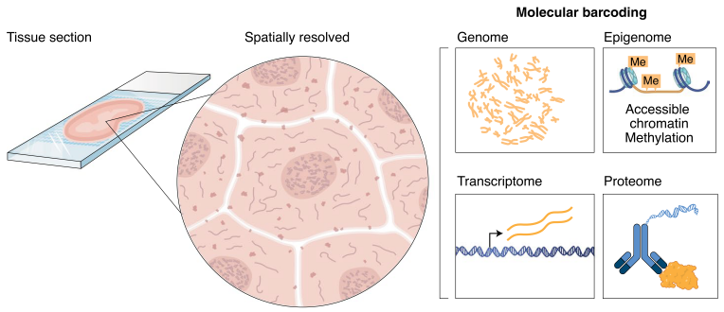
Spatially resolved transcriptomics adds a new dimension to genomics
-- Joakim Lundeberg @ KTH Royal Institute of Technology, Sweden
Cryosectioned tissue slices are placed atop the microarray
Networks
cell-cell and gene-gene
Spatially barcoded probes are printed as microarrays of spots on the surface of glass slides or beads
After enzymatic permeabilization, the released mRNAs hybridize with the surface probes

Slide 4
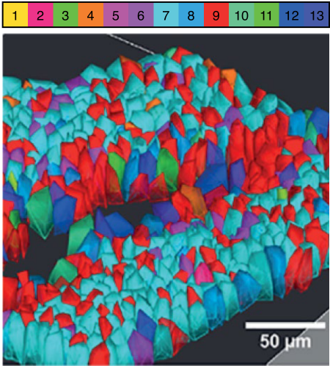
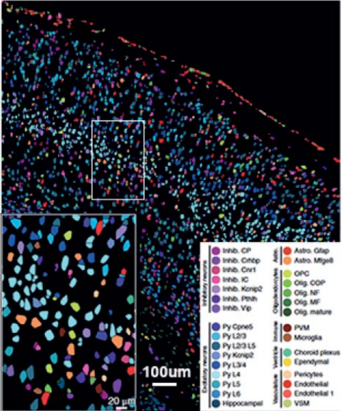
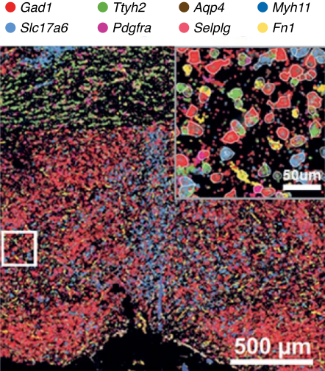
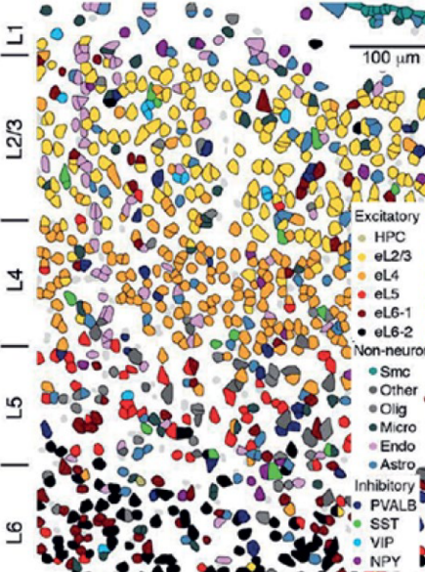
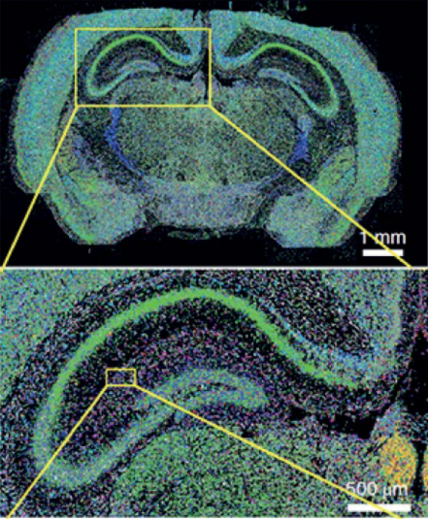
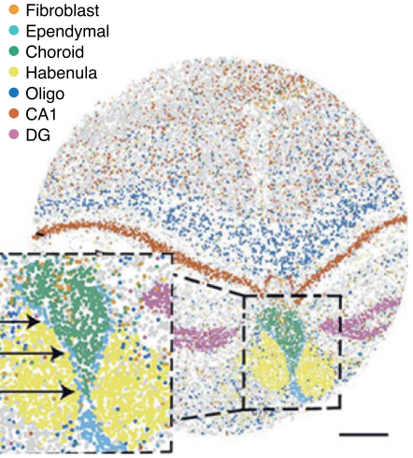
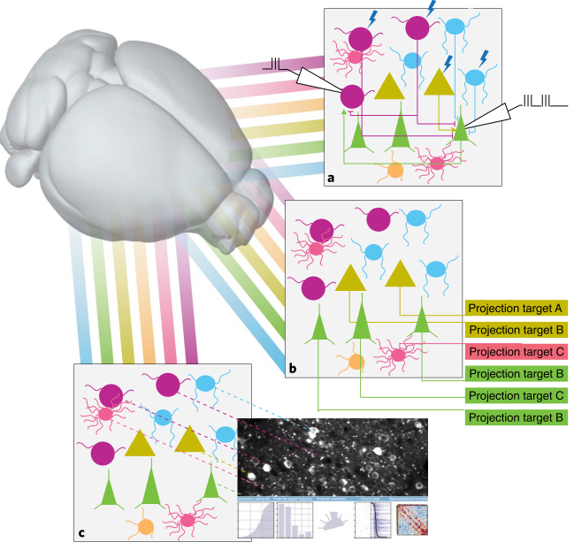
Spatially resolved transcriptomics in neuroscience
-- Hongkui Zeng @ Director of Allen Institute for Brain Science, USA
seqFISH (Neuron, 2016)
dentate gyrus
13 genes
osmFISH (Nat Methods, 2018)
Somatosensory cortex
31 cell types
39 genes
MERFISH (Science, 2018)
hypothalamic preoptic area
70 cell types
155 genes
STARmap (Science, 2018)
visual cortex
16 cell types
160 genes
pciSeq (Nat Method, 2020)
hippocampus
99 genes
Cell-type-dependent local connectivity
Multi-patch (1991 Nobe Prize)
Optogenetics (Method of the Year 2010)
More opportunities for both technology and methodology!
Long-range projection
Barcoded anterograde or retrograde viral labeling
Slide-seq (Science, 2019)
hippocampus
large scale
transcriptome-wide
Add cell type identities to circuit analysis
Spatially resolved transcriptomics
Calcium imaging

Slide 5
Method of the Year 2007-2020 @ Nature Methods
2007: Next-generation sequencing (1980 Nobel Prize for Sanger) (Ray Wu 吴瑞)
2008: Super-resolution fluorescence microscopy (2014 Nobel Prize) (Xiaowei Zhuang 庄小威)
2009: Induced pluripotent stem cells (2012 Nobel Prize) (Hongkui Deng 邓宏奎)
2010: Optogenetics (Feng Zhang 张锋)
2011: Genome editing (ZFN, TALEN) (2020 Nobel Prize for CRISPR) (Feng Zhang 张锋, David Liu 刘如谦)
2012: Proteomics (2002 Nobel Prize for mass spectrometry) (Fuchu He 贺福初)
2013: Single-cell sequencing (Fuchou Tang 汤富酬, Xiaoliang Sunney Xie 谢晓亮)
2014: Light-sheet fluorescence microscopy
2015: Single-particle cryo-electron microscopy (2017 Nobel Prize) (Yigong Shi 施一公)
2016: Epitranscriptomics (Chuan He 何川)
2017: Organoids (Yu Chen 陈宇)
2018: Imaging in freely behaving animals (Heping Cheng 程和平)
2019: Single-cell multimodal omics (Fuchou Tang 汤富酬)
2020: Spatially resolved transcriptomics (Xiaowei Zhuang 庄小威，Long Cai 蔡龙)
Sequencing
Imaging

Slide 6
Thanks

